Slide 1
P2PE, Security & Mobile Payments
Miguel Gracia & David Natelson
April 15, 2019

Slide 2
Agenda
Data Breaches Continue
Data Security Standards
Risks of Handling Payment and Sensitive Data
Point-to-Point-Encryption
Tokenization
Mobile Payments (David Natelson)
Q & A

Slide 3
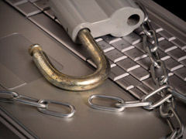
Data Breaches Continue to Occur
Verizon Data Breach Investigation Report (DBIR) – Reputable resource
    Collects and reports data breach incident data (since 2007)
    Data is collected across multiple industries
2018 Verizon DBIR Report
    Over 53,000 (of which 2, 216 were confirmed) data breaches
    73% of breaches were perpetrated by outsiders
    Small businesses and Healthcare organizations experienced the highest percent of breaches
    58% of the breached victims were small businesses
    48% of the breaches were related to hacking with malware
    49% of the breaches involved non-POS malware installed via email
    76% of the breaches were financially motivated
    68% of the breaches took months or longer to discover
¹Security Breach State Level Legislation
    NC was one of the first states to pass laws in 2005 (Senate Bill 1048) now N.C. Gen. Stat §§ 75-61, 75-65
      Notification to NC State Consumer Protection Bureau for breaches affecting more than 1,000 people
      https://www.ncdoj.gov/getdoc/81eda50e-8feb-4764-adca-b5c47f211612/Report-a-Security-Breach.aspx
    50 States have had security breach notification bills
    States with newly enacted legislation in 2018 - AL, AR, CA, CO, CT, HI, IA, IL, KY, LA, MD, MA, MI, MO, NE, NH, NM, NY, OH, OR, SC, SD, UT, WA, DC
¹Source: http://www.ncsl.org/research/telecommunications-and-information-technology/2018-security-breach-legislation.aspx

Slide 4
Data Breaches Continue to Occur
Data Breach Patterns Identified
    Nine emerging data breach patterns identified from data collected over a 10-year period
    Patterns:
      Denial of Service (massive traffic load which disables web application access)
      Privilege Misuse (e.g., too many user accounts with access to sensitive data)
      Crimeware (e.g., malware, keylogger, viruses)
      Web applications (unsecured web applications)
      Lost and Stolen assets (lost computers/data)
      Miscellaneous Errors (human error – e.g., writing down sensitive data, unsecured workstations)
      Cyber-Espionage
      Point of Sale
      Payment Card Skimmers
      Note: 333,000 incidents and over 16,000 data breaches reported reveal that 94% of security
      incidents and 90% of data breaches fit within one of the 9 patterns.
The ²2018 DBIR report shows that:
    Point-of-Sale systems in the Accommodation industry experienced 302 breaches.
    Most of the breaches involved hacking or malware
    Web applications were targeted across all industries
    Most of the breaches occurred within physical servers and software applications
²Source: https://enterprise.verizon.com/resources/reports/dbir/

Slide 5
2018 Data Breaches Reported by the Media
Payment Account Data Breaches
    Saks Fifth Avenue and Lord & Taylor - 5 million records (April 2018)
    British Airways - 380,000 records (August 21, 2018 — September 5, 2018)
    Orbitz - 880,000 records (March 2018)
    Best Buy - unknown number of records (April 2018)
    Delta Airlines - unknown number of records (April 2018)
    Macy's - unknown number of records (April 2018)
    Sears/K-Mart - around 100,000 records (April 2018)
Personal Account Data Breaches
    Panera Bread - unknown number of records (April 2018)
    Ticketfly - 27 million records (May 2018)
    Google+ - 52.5 million records (March 2018)
    Quora - 100 million records (November 2018)
    Under Amour 150 million records (March 2018)
    T-Mobile - around 2 million records (August 2018)
    Adidas - unknown number of records (June 2018)
    Facebook – 29 to 50 million records (July 2017 - September 2018)
    Marriot - 500 million records (September 2018)
    Aadhar – 1.1b citizens of India (March 2018), India's government ID biometric database
Total cost of the breach/number of records
Source: 2018 by Ponemon Institute LLC and IBM Security

Slide 6
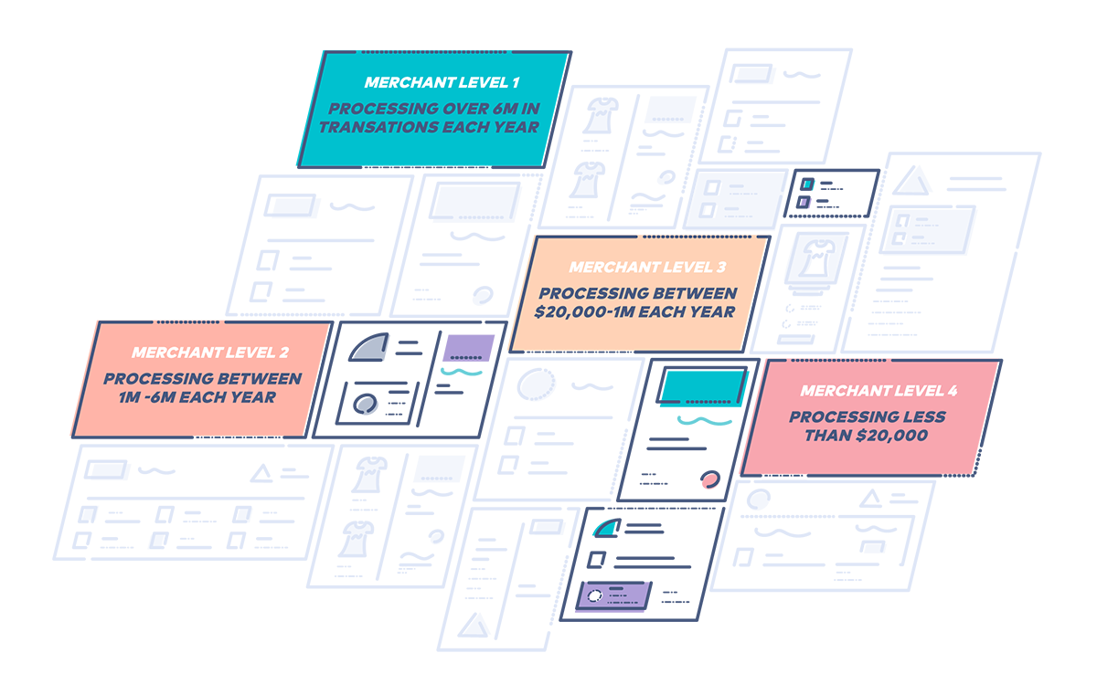
Data Security Standards
Payment Card Industry Data Security Standards (PCI DSS)
    A set of data security standards for protecting sensitive data
    Define the do’s and don'ts when protecting payment card data
    Established by the Card Brands (Visa, Mastercard, Discover, Amex and JCB)
    Assist merchants in navigating the complexity of protecting sensitive payment data
Payment Card Industry Security Standards Council (PCI SSC)
    Established by the card brands in 2006
    Manages PCI DSS standards
    Manages the ongoing evolution of the PCI security standards
    Maintains focus on improving payment account security for credit card payments.
    To learn more visit Council’s website at https://www.pcisecuritystandards.org

Slide 7
Risks of Handling Credit Card or Personal Data
Risks of Fraud
    Bypassing payment data validations (postal code and CVV)
    Lacking a fraud prevention solution within Ecommerce sites
Risks of Data Breach
    Using unencrypted devices when accepting sensitive data
    Not monitoring network access against intrusions
    Lacking a process for handling data security incidents
    Accepting credit card data in clear text via web applications
    Using credit card devices with self-managed device encryption keys
    Using unsecured data networks or channels (e.g., weak Wi-Fi connectivity or passwords, taking card data over the phone)
    Storing unencrypted payment data within systems
    Overlooking human error – e.g., user account sharing, unrestricted access, untrained staff handling payment data
    Storing or transmitting encrypted sensitive data with locally stored decryption keys
    Recording card data received via phone calls (call center)

Slide 8
Risks of Handling Credit Card or Personal Data
Risks of POS Malware
    Running an out-of-date POS software application
    Transmitting POS data in clear-text
    Lacking anti-virus software for all workstations
    Configuring POS workstations in a publicly accessible network
    Exposing POS systems to any user
Risks of Identity Theft
    Storing (encrypted or unencrypted) sensitive personal data
    Lacking Phishing scam training and prevention software - (The attempt to obtain sensitive data by disguising as a trustworthy entity via email or web links)
    Lacking processes to counteract Social Engineering (The art of manipulating people, so they give up confidential information)
    Lacking staff training to keep safeguards on sensitive information
    Entering sensitive data into websites that do not have a valid security certificate
    Providing unsecured open data networks that allow passing sensitive data via unencrypted channels

Slide 9
Risks of Handling Credit Card or Personal Data
Risks of High PCI Compliance Costs
    Using non-PCI validated payment processing technologies (incurs high PCI costs while exposing a business to data breach risk)
    Lacking data security processes and technology (incurs yearly hefty compliance costs - including fines up to $500k)
    Not selecting a payment gateway service provider that complies with PCI standards
    Not adopting a PCI scope reduction solution across all payment processing channels.
Source: 2018 Trustwave Global Security Report https://www2.trustwave.com/GlobalSecurityReport.html

Slide 10
Point-to-Point Encryption (P2PE)
What is Point-to-Point Encryption?
    A combination of secure devices, applications and processes to encrypt and protect data throughout the entire transaction
    Uses hardware-to-hardware encryption and decryption process
    Makes card data completely invisible within the merchant’s environment.
    Solution includes merchant education in the form of a P2PE Instruction Manual (PIM)
    Encrypted data isn't decipherable to anyone who might steal it during the transaction process
    Helps organizations protect themselves and their customers from a costly data breach
    Is ranked as a high security solution by the PCI council and security experts
PCI-Validated P2PE Solution
    Not all P2PE solutions are validated by the PCI Council.
    To reduce PCI scope, merchants must select a P2PE solution listed within the PCI Council website
    Non PCI listed solutions have not met the PCI P2PE standards and will not offer reduced PCI scope for a business
    Only Council-listed P2PE solutions are recognized as meeting the requirements

Slide 11
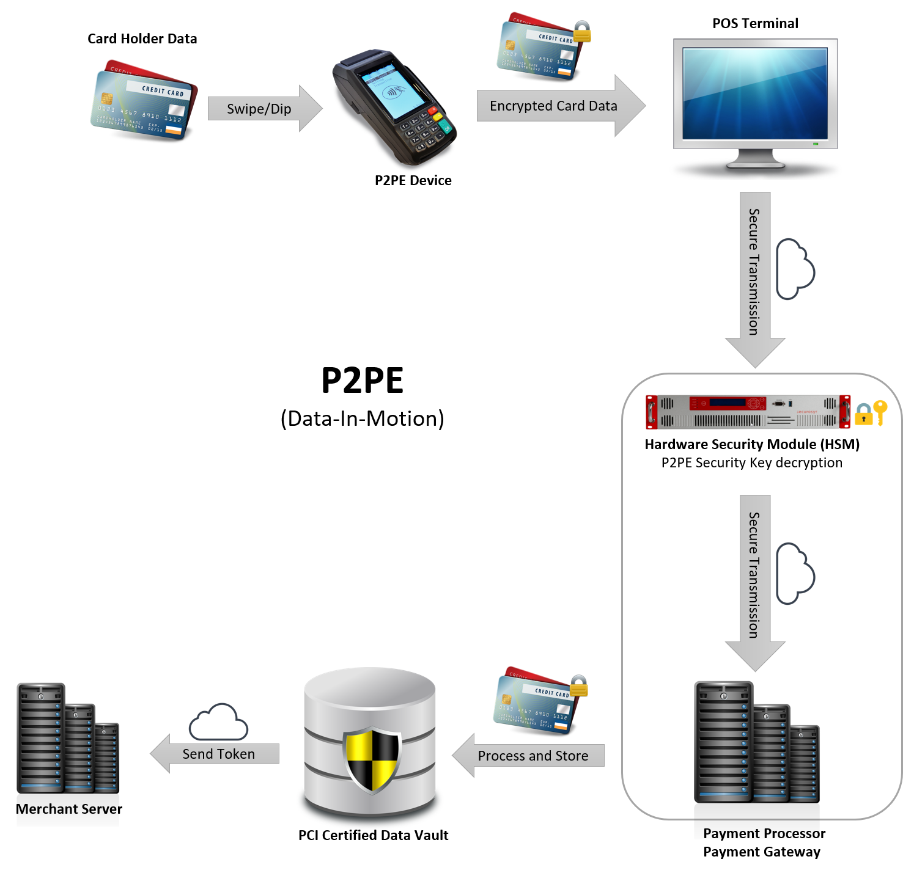
Point-to-Point Encryption (P2PE)

Slide 12
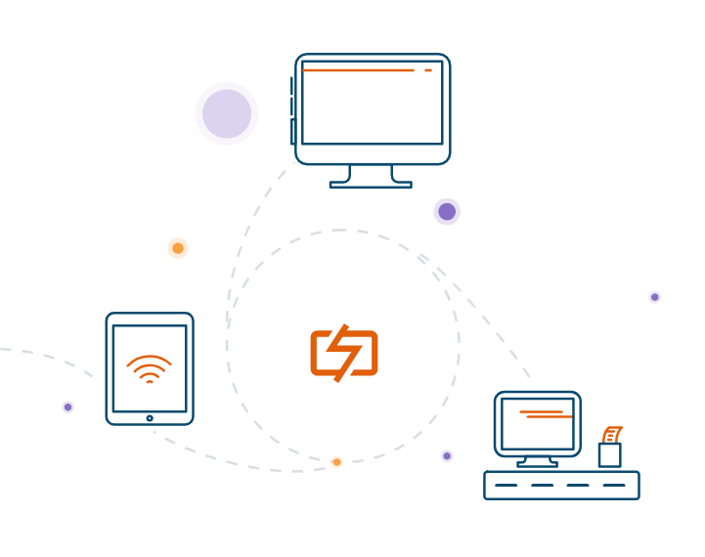
Point-to-Point Encryption (P2PE)
How Does P2PE Work?
    Immediately encrypts data at the point-of-interaction (POI) - as the data is keyed, dipped or swiped
    Uses strong encryption keys (e.g., TDES-DUKPT, AES, RSA, etc.)
    From the POI, the data is sent to the solution provider via a secured connection (HTTPS\TLS1.2)
    Solution provider uses a decryption key (stored within a Hardware Security Module or HSM) to retrieve the original card data
    Encryption/Decryption keys are never available to anyone but the solution provider
    Shifts data protection liability to the solution provider
    Solution provider passes the data the credit card issuing bank for authorization
    Once the transaction is processed, merchant receives the authorization status (approved/declined) along with a credit card token from the solution provider
    The merchant can store the token and re-use it for subsequent transactions. No need for retaining the original card data.

Slide 13
Point-to-Point Encryption (P2PE)
PCI Council Validated P2PE Solution Benefits
    Simplifies PCI compliance efforts - fewer PCI DSS requirements.
    Saves time and money as PCI requirements are greatly reduced.
    Shorter PCI Self-Assessment questionnaire (P2PE-HW – 35 controls)
    Protects a business in the event of fraud, the P2PE Solution Provider, not the merchant, is held accountable for data loss and any resulting fines

Slide 14
Tokenization
What is Tokenization?
    A technology that enables the creation of data tokens for a variety of sensitive data (credit card data, SSN, email, phone, license, etc.)
    Provide the ability to detokenize sensitive data (usually not credit cards due to risk) to obtain the original data
    Is based on a unique set of encryption keys for the generation of tokens
    Exclusive tokens generated for a specific business cannot be used by another business
    Allows the exchange of tokenization requests via secure connectivity (e.g., SSL\TLS 1.2 connection)
    Often confused with point-to-point encryption (P2PE), as both solutions involve converting sensitive data into data that is useless to hackers
    P2PE is paired with tokenization to produce a randomly generated number that represents a payment card
    The token length and format vary per solution provider
    This randomly generated number can be reused to process future transactions via the solution provider’s payment gateway
    A token does not contain credit card data, is not a value that can be decrypted back into the original credit card
    Credit card tokens generally reflect the last 4 digits of the credit card but may also include the first 2 or 6 digits (BIN number) of the card.
    A business can store the token without the burden of on-going PCI compliance related to storing card holder data

Slide 15



Where
threats lie
Card swiped
at POS
PAN transmitted in the clear to the POS and then Acquirer
Acquirer sends authorization to Issuer
Merchant stores
PCI “card data”
Acquirer returns non-tokenized response to Merchant
Issuer sends authorization response to Acquirer

Slide 16
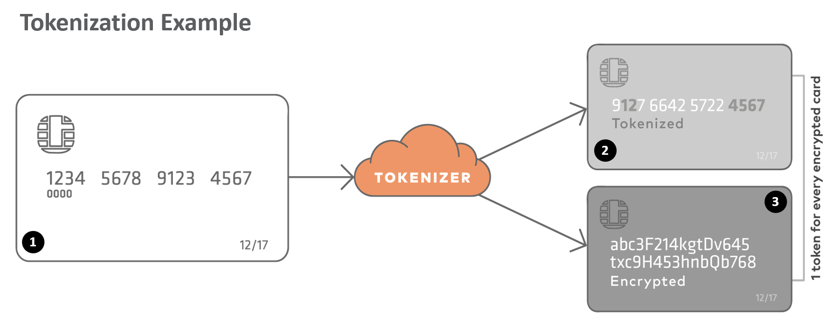
Tokenization

Slide 17
Tokenization
Benefits of Tokenization
    Reusable Protection: Protects cardholder data at many points in the transaction lifecycle, post-authorization and for recurring transactions
    Reduces Administrative and PCI Compliance Costs: Tokenization simplifies PCI compliance by reducing scope associated with storing payment card data. Because card data is no longer being stored, the amount of time and resources associated with the protection of data is reduced.
    Devalues Breached Data: Tokenization removes all card holder data stored in systems and applications and replaces it with numbers that are useless to an attacker. Tokens cannot be unencrypted to generate the original credit card number.
    Simplifies PCI Compliance: Tokenization reduces PCI scope audits and complexity. Merchants using tokenization qualify for shorter PCI SAQs
    Reduces Liability: tokenization can be leveraged to comply with the General Data Protection Regulation (GDPR) to reduce risk of financial liability
    Internal Data Protection: Tokenization also minimizes internal and external data exposure to people within an organization (employees, vendors and suppliers)
    Online Data Protection: Merchants can leverage tokenization across multiple payment channels to eliminate risk of data breach
    Protects Multiple Data Types: Tokenization can be leveraged to protect Personally Identifiable information (ss numbers, phone, email, date of birth, license data, credentials)

Slide 18


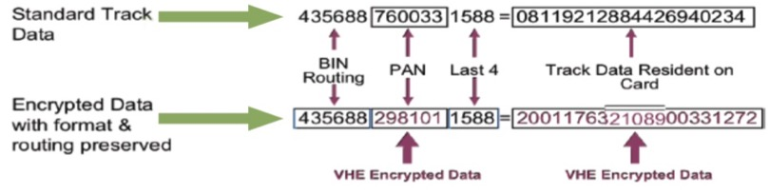

TransArmor® is both E2EE & P2PE
Merchant
Encrypted
Merchant
Data Center
Encrypted
Gateway/
FD Front-end
Encrypted
TransArmor Tokenized Response
TransArmor Tokenized Response
TransArmor
Tokenized Response
PKI Encryption
Not a format-preserving encryption
Supported on a wide range of devices
Verifone® Edition Encryption
Format preserving encryption
Supported on most VeriFone devices
Triple DES DUKPT Encryption
Not a format preserving encryption
Near universal device support
4356 8876 0033 1588 =

Slide 19
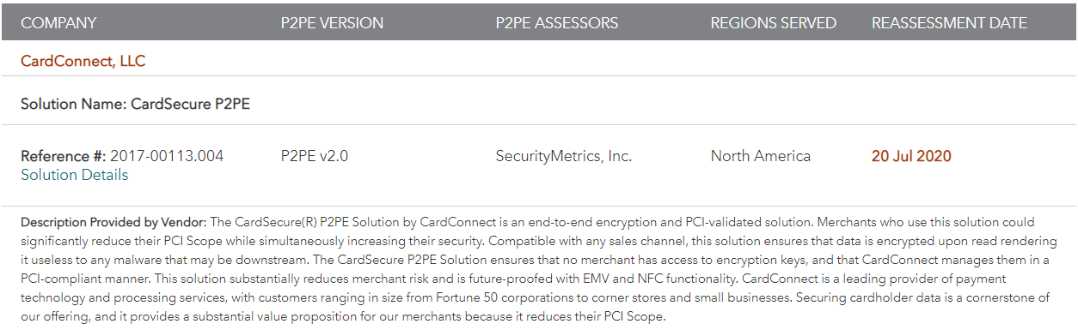
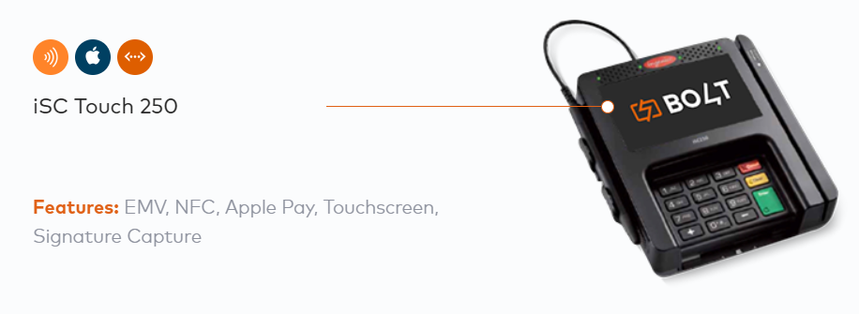
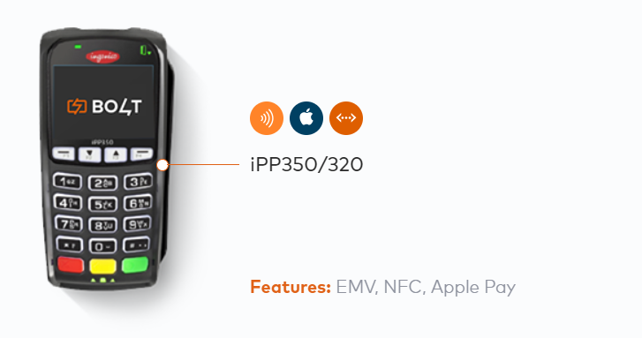
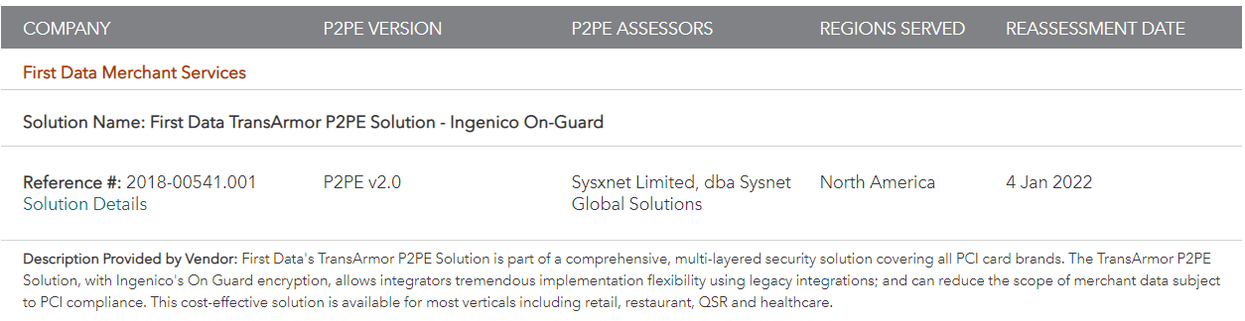

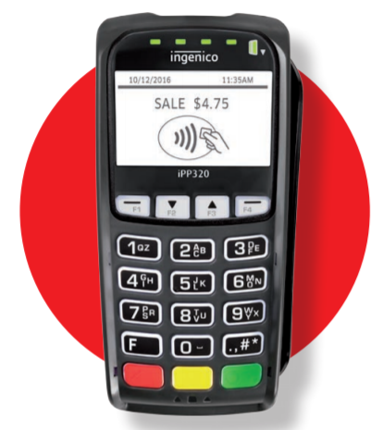
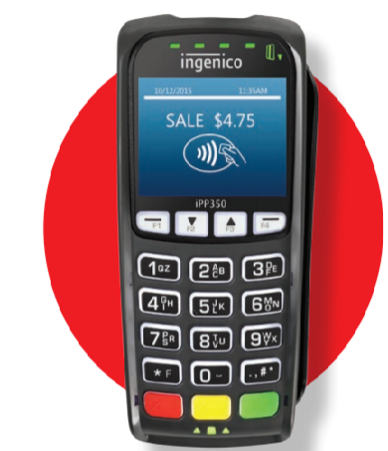
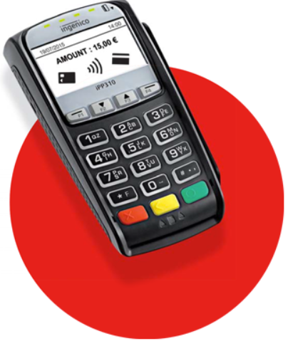
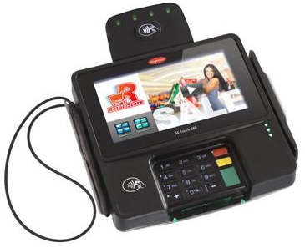
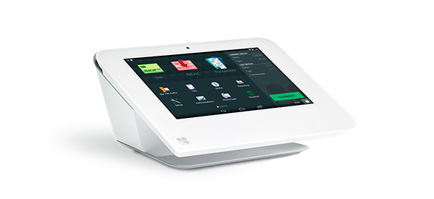
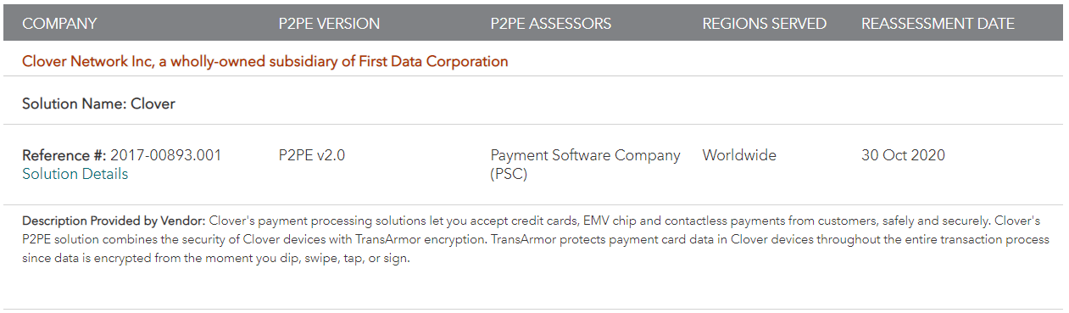
Summary – current PCI Validated P2PE Solutions from First Data
https://www.pcisecuritystandards.org/assessors_and_solutions/point_to_point_encryption_solutions
Ingenico iSC250 Touch, iSC480, iPP320, iPP350, iPP310
Clover Mini
Accept swipe, EMV chip and NFC payments right out of the
Look for more brands and devices in 2019…

