Slide 1
Reducing the Costs of
Disbursements
With prepaid card solutions
2015 Governmental Account and
Financial Management Update
Doris N. Dixon, Director, Senior Prepaid Card Specialist
June 5, 2015

Slide 2
Electronic payments
Initiate
Reconcile
Research
Forecast
$4
Leading companies
are taking advantage of the up to 75% cost savings by going from paper checks to electronic payments
paper process
Average cost
per check payment³
vs
$1
electronic process
or less internal cost
for electronic payments
Paper to electronic (P2E) consumer payments mean more “green” to your bottom line
84%
Because trees remove carbon dioxide from the earth’s atmosphere, cutting them down to produce checks actually speeds up climate change (a tree can only produce, on average, 17 reams of paper and takes about 100 years to grow¹). The benefits of going paperless are enormous.
Going electronic for payments means fewer file cabinets in the landfill, fewer printer cartridges and less ink and toner.
of respondents cited reducing overall processing costs was the top factor for driving a focus on electronic payments²
2/2015 http://paperlessproductivity.com/eco-impact/ 2. Electronic Supplier Payments; PayStream Advisors Q3 2013
3. Anecdotal estimates shared with us by our clients have ranged as high as $25 per payment. In recognition of the variability of costs across our clients and of the presumed partial cost offset offered by check float, Bank of America typically references a conservative estimate of $4 per check when discussing the potential benefit of electronic payments.

Slide 3
Electronic payments help with fraud prevention
“
60%
  Companies are moving away from manual, paper-based payments to help deter fraudulent activity. ¹
of companies surveyed experience attempted or actual payments fraud¹
82%
”
reported checks were the primary target for fraud attacks at their companies¹
Common cases of fraud
Solutions being implemented
Altered checks
Organized crime
Malicious insiders
Hacked systems
Spyware
Digital disbursements
ACH positive pay solutions
Card solutions
Check outsourcing
“
As the EMV is adopted in the United States, and credit cards become a less attractive payment method to attack, fraudsters will follow the path of least resistance: checks. ²
”
2014 AFP Payments Fraud and Control Survey
KOFAX White Paper • Verify Checks in Real-Time: Meet Customer Expectations While Reducing Fraud, 1/2015

Slide 4

Business to Business (B2B) - Payment solutions for every type of spend
Convert paper-based payments to electronic transactions
ACH
Paymode-X®
Invoiced spend
ePayables
Direct vendor spend
Purchasing Card
Indirect/low-dollar spend
Travel-related spend
Travel Card

Slide 5
Business to Consumer (B2C) - Options to replace costly paper checks
 | B2C Payment profile | Anticipated benefits
ACH Transfers (Automated Clearing House) | Used for non-recurring and recurring payments Most cost effective payment method if customer will share account information Broadly used, highly reliable Robust remittance capabilities Bank account required | Submit payments online or via transmitted file Establish recurring payments to reduce cost Pay on the next or a future business day—you set the date Electronic deposit on an automated basis No lost or stolen checks
Prepaid Card | Use for recurring and non-recurring payments Established payment type—accepted world-wide Faster and less costly processing when compared with paper checks No bank account required | Provides a branded reminder in your customers’ wallet Fast and easy to use—on an automated basis requires less manual intervention than checks Provides greater security then paper checks

Slide 6

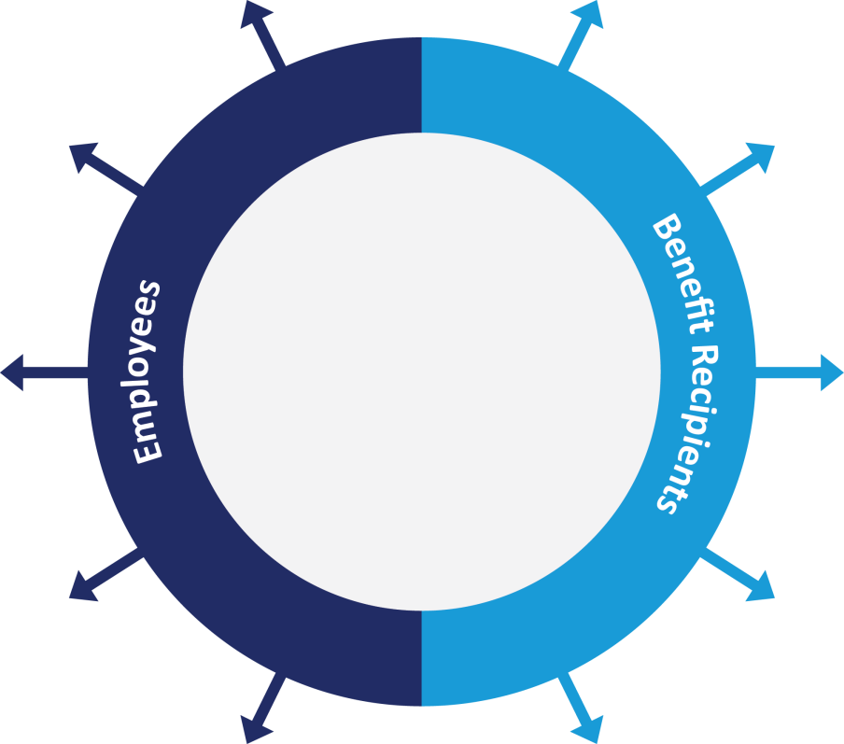

BofAML Prepaid Cards
      Meet regulatory compliance – Management of the escheatment process and help ensure compliance with the various state laws
      Streamline administration – by eliminating difficult, time-consuming reconciliation process
      Reduce expenses – reduce costs associated with check production, reconciliation, bank fees and customer replacement requests
      Reduce risk exposure – eliminates check fraud exposure and improves audit reporting
      Security/safer than cash – improves safety, fraud protections and provides 24/7 customer care. If lost or stolen, the unspent amount can be replaced
      More choices & convenience – Unlike gift certificates and checks, customers have access to use funds wherever Visa or MasterCard debit cards are accepted
      Online activation and balance availability – Cardholders can activate their cards immediately and have 24/7 access to their available balance
Retirement/
pension
Unemployment/
disability
Payments/
reimbursements
Lottery
Incentives/
rewards
Government
Other benefits
Payroll
Tax refunds
Worker’s compensation
Child support

Slide 7



BofAML Prepaid Cards for Higher Education
Financial aid/
reimbursements
Retirement
Travel Payments/
reimbursements
Athletic
Per diems
      Meeting the same benefits of regulatory compliance, streamlined administration, reduced expenses, reduced risk exposure, security/safer than carrying cash, more choices & convenience, online activation and balance activity
College or University
Grant payments
Research
Study payments
Per diems
(domestic/international)
Payroll/
Federal work study

Slide 8
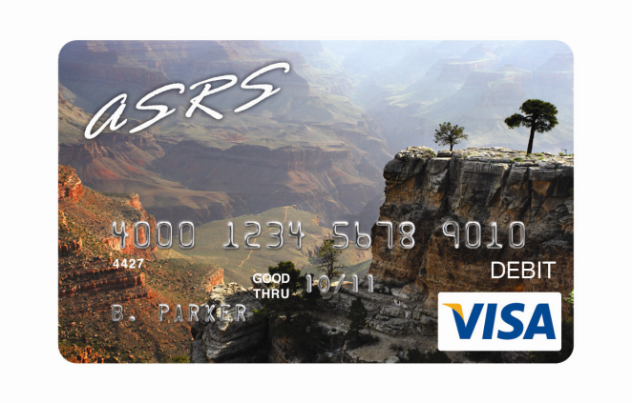
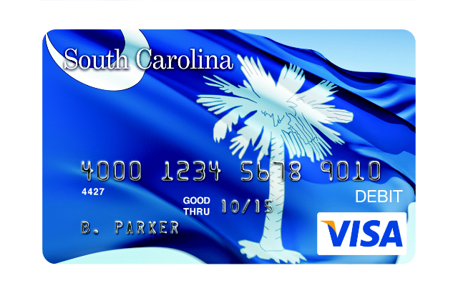
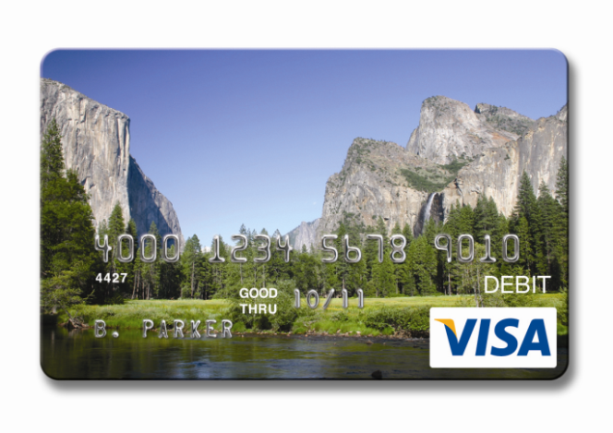
Bank of America Government Prepaid
        Current State-level Bank of America Programs:
        State of Arizona – Payroll, Retirement, Unemployment, Child Support
        State of California – Unemployment, Disability
        State of Georgia – Income Tax Refund
        State of Iowa – Unemployment
        State of Kansas – Unemployment
        State of Maryland – Child Support, Unemployment
        State of Michigan – Unemployment
        Commonwealth of Massachusetts –Unemployment, Child Support
        State of New Hampshire - Payroll
        State of New Jersey – Unemployment, Disability, Payroll
        State of New York – Income Tax Refund
        State of North Carolina – Unemployment (Launch July 2015)
        State of South Carolina – Unemployment, Income Tax Refund
        State of Texas – Payroll
        State of Virginia – Lottery
        State of Washington – Child Support

Slide 9
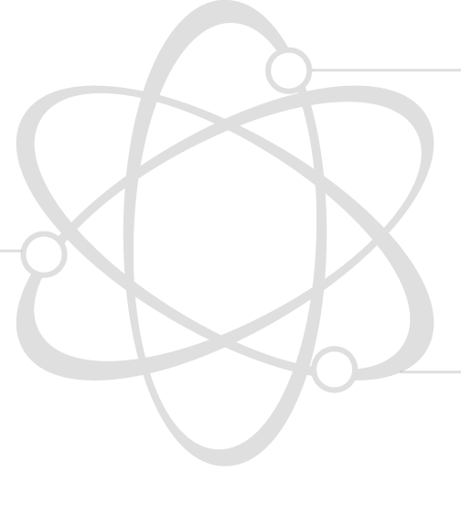
BofAML prepaid program features
24/7 support for your cardholders
Customer service is available through an online website, toll-free telephone access to an IVR of live agent call center
Flexible Product Structures Multiple product design and structure options, including ATM access.
Dedicated Client Support support including account management, implementation and client support hot line
Easy to implement
You are assigned an implementation project manager to provide complete support as you design and launch your program
Easy to administer
Secure web-based tools to manage your program and access reporting

Slide 10
Use case: Unemployment insurance benefits
Recurring payments through prepaid cards
Personalized
Features
Supported
      Personalized cards issued to Unemployment Insurance recipients
      Trade Readjustment Allowance and additional unemployment benefits eligible
      Primary funding via ACH direct deposit
      Reloadable
      Purchases everywhere Visa debit cards accepted, plus cash access via ATMs and financial institutions
      Online funds transfers
      Emergency cash transfers via Western Union
      24/7/365 Cardholder customer service by toll-free phone line and online customer service
      Fully customized implementation with technical lead and dedicated implementation engineer resources
      Marketing and transition support
      Fully automated enrollment and reporting support via data file transmissions
      Web portal administration option
      Dedicated Card Account Manager and Prepaid Client Support for agency administrators

Slide 11
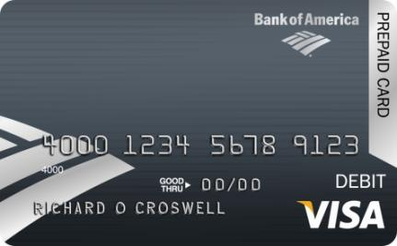
Use Cases: Per diems & research study payments
Per Diems
Student & Employee Per Diems
      Supports consumer-owned funds – study abroad, NCAA athletic per diems, student activity programs, infrequent traveler
      Supports business-owned funds – athletic department coaches/managers, grant funds
      Personalized cards w/mail delivery – order cards as you need them; we personalize and mail them to the cardholder; logo option
      Instant issue cards - non-personalized, non-loaded/non-activated, can upgrade to personalized cards
      Reloadable or one-time issuance; Point-of-sale and/or cash access
      24/7 enrollment & funding via web-based tool
      Client reporting package
      Escheatment liability shifts to bank
      24/7 cardholder customer service, with FDIC insurance and zero liability coverage (consumer funds programs)
Research Study Payments
Student & Consumer Payments
      Supports registered, anonymous or self-service reward cards
      Personalized cards w/mail delivery – order cards as you need them; we personalize and mail them to the cardholder; logo option
      Instant issue cards - non-personalized, non-loaded/non-activated, can upgrade to personalized cards
      Reloadable or one-time issuance; Point-of-sale and/or cash access
      Anonymous cards – no cardholder data passed, instant issue non-reloadable, maximum value $1,000.00, cash access ONLY
      24/7 enrollment & funding via web-based tool
      Client reporting package
      Escheatment liability shifts to bank
      24/7 cardholder customer service, with FDIC insurance and zero liability coverage
Notes:
Instant Issue Cards - non-personalized, non-loaded/non-activated
Reloadable and with variable load values; up to $5,000
ATM & Cash Access
Web portal with security functions to segregate funding and enrollment
Administrative and Card inventory management system
Reward Cards
Self-Service Reward
Instant-Issue Only - Pre-funded, non-reloadable, non-personalized, non-activated, not registered
Promotional/Incentive Cards - 9 month expiration; remaining card balances are forfeited
Pre-set value per order , you choose the dollar amount ($10-$1,000)
No Cash Access
Order cards only as you need them
Clients can return unused cards prior to expiration date for refund
Flexible options to customize your cards:
Choose from 7 cards designed for reward/incentive programs
Add your company’s logo
Client reporting package & administration capabilities are not available

Slide 12
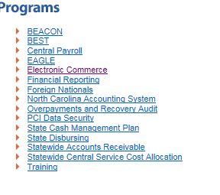
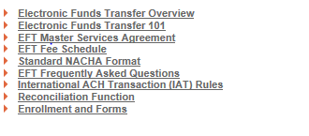
How to Participate
How to enroll in the program
Start by visiting the Office of State Controller’s website http://www.osc.nc.gov/
Under the programs tab select Electronic Commerce.
1
Under
Construction
2
Then select EFT Services from the left table of contents and then Enrollment and Forms.
3
Complete the Agency Participant Agreement and Participant Setup Form. OSC and Bank of America associates are available to review the setup form.
4
Upon receiving the approved form from the Office of the State Controller and Department of the State Treasurer, Bank of America associates will contact you to review program options .

Slide 13
Questions &
Open Discussion

Slide 14
Notice to Recipient
"Bank of America Merrill Lynch" is the marketing name for the global banking and global markets businesses of Bank of America Corporation. Lending, derivatives and other commercial banking activities are performed globally by banking affiliates of Bank of America Corporation, including Bank of America, N.A., member FDIC. Securities, strategic advisory, and other investment banking activities are performed globally by investment banking affiliates of Bank of America Corporation ("Investment Banking Affiliates"), including, in the United States, Merrill Lynch, Pierce, Fenner & Smith Incorporated and Merrill Lynch Professional Clearing Corp., both of which are registered as broker-dealers and members of FINRA and SIPC, and, in other jurisdictions, by locally registered entities. Merrill Lynch, Pierce, Fenner & Smith Incorporated and Merrill Lynch Professional Clearing Corp. are registered as futures commission merchants with the CFTC and are members of the NFA. Investment products offered by Investment Banking Affiliates: Are Not FDIC Insured * May Lose Value * Are Not Bank Guaranteed.
This document is intended for information purposes only and does not constitute a binding commitment to enter into any type of transaction or business relationship as a consequence of any information contained herein.
These materials have been prepared by one or more subsidiaries of Bank of America Corporation solely for the client or potential client to whom such materials are directly addressed and delivered (the “Company”) in connection with an actual or potential business relationship and may not be used or relied upon for any purpose other than as specifically contemplated by a written agreement with us. We assume no obligation to update or otherwise revise these materials, which speak as of the date of this presentation (or another date, if so noted) and are subject to change without notice. Under no circumstances may a copy of this presentation be shown, copied, transmitted or otherwise given to any person other than your authorized representatives. Products and services that may be referenced in the accompanying materials may be provided through one or more affiliates of Bank of America, N.A.
We are required to obtain, verify and record certain information that identifies our clients, which information includes the name and address of the client and other information that will allow us to identify the client in accordance with the USA Patriot Act (Title III of Pub. L. 107-56, as amended (signed into law October 26, 2001)) and such other laws, rules and regulations.
We do not provide legal, compliance, tax or accounting advice. Accordingly, any statements contained herein as to tax matters were neither written nor intended by us to be used and cannot be used by any taxpayer for the purpose of avoiding tax penalties that may be imposed on such taxpayer.
For more information, including terms and conditions that apply to the service(s), please contact your Bank of America Merrill Lynch representative.
Investment Banking Affiliates are not banks. The securities and financial instruments sold, offered or recommended by Investment Banking Affiliates, including without limitation money market mutual funds, are not bank deposits, are not guaranteed by, and are not otherwise obligations of, any bank, thrift or other subsidiary of Bank of America Corporation (unless explicitly stated otherwise), and are not insured by the Federal Deposit Insurance Corporation (“FDIC”) or any other governmental agency (unless explicitly stated otherwise).
This document is intended for information purposes only and does not constitute investment advice or a recommendation or an offer or solicitation, and is not the basis for any contract to purchase or sell any security or other instrument, or for Investment Banking Affiliates or banking affiliates to enter into or arrange any type of transaction as a consequent of any information contained herein.
With respect to investments in money market mutual funds, you should carefully consider a fund’s investment objectives, risks, charges, and expenses before investing. Although money market mutual funds seek to preserve the value of your investment at $1.00 per share, it is possible to lose money by investing in money market mutual funds. The value of investments and the income derived from them may go down as well as up and you may not get back your original investment. The level of yield may be subject to fluctuation and is not guaranteed. Changes in rates of exchange between currencies may cause the value of investments to decrease or increase.
We have adopted policies and guidelines designed to preserve the independence of our research analysts. These policies prohibit employees from offering research coverage, a favorable research rating or a specific price target or offering to change a research rating or price target as consideration for or an inducement to obtain business or other compensation.
Copyright 2015 Bank of America Corporation. Bank of America N.A., Member FDIC, Equal Housing Lender.

